Slide 1

Stage 4:
Functional Suncatchers
Hcpl.net
What do you remember from the last class?
What did you like the best?
Any questions?

Slide 2
Objectives
Students will:
Learn to find patterns in processes
Think about an artistic task in a different way
Interpret symbols as they relate to physical manipulatives

Slide 3
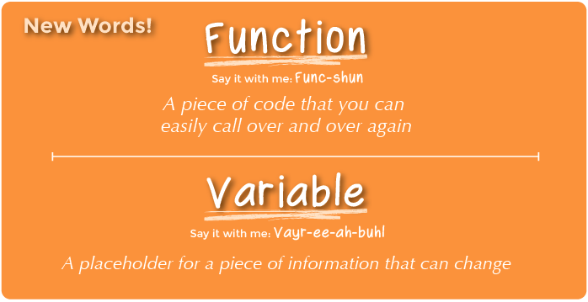
Vocabulary
Function - Say it with me: Func-shun
A piece of code that you can easily call over and over again
Variable - Say it with me: Vayr-ee-ah-buhl
A placeholder for a piece of information that can change

Slide 4
Video
https://studio.code.org/s/course3/stage/4/puzzle/1

Slide 5
Follow directions to create suncatchers
Use:
  Beads
  Spacers
  Special charms
  Knots
The directions are an algorithm: a set of steps telling you what to do.

Slide 6
Example
Find what skill number makes the given words and drag the words onto the given sequence to the left.
For Example: Skill 1 and Skill 2 make the word “STACK”

Slide 7
Directions
Complete the 2 levels onto Stage 4

